Slide 1

SQL SERVER - OPTIMIZING STORED PROCEDURE PERFORMANCE

Slide 2
Processing Stored Procedures
Stored Procedures Plans Caching
Plan Quality Problems
When to Recompile
Key Problem with Recompile
The Hybrid Approach

Slide 3
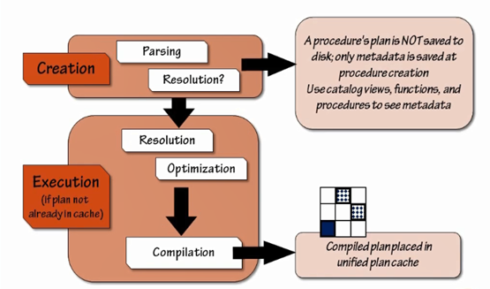
Processing Stored Procedures

Slide 4
What Happens When You Create a Procedure?
SQL Server parses the SP to make sure there are no syntactical error
Object resolution refers to verifying the referenced objects and their dependencies
  When ALL of the dependent objects exists
    All refinances are verified
    Finds small errors right away
  If ANY of the dependent objects do not exists
    ALL references are differed until first runtime
    Might not find a small error/typo until testing
  Once the SP is successfully parsed (regardless) of resolution, the object is placed into the system tables (the metadata is added)

Slide 5
Plan Quality Problems
When is having a plan is cache a bad thing?
  When do you want to recompile?
  What options do you have for recompilation, and at what granularity?
  How do you know you need to recompile?
  Do you want to recompile the entire procedure or only part of it?
  Can you test it?
RCOMPILATION = OPTIMIZATION
OPTIMIZATION = RCOMPILATION
If a plan is not stable then it might be best not save it…

Slide 6
Stored Procedure Plans and Caching
Plan is generated when no plan already exists in cache
Plan are never saved on disk and may not persist within cache
  Some operations completely remove / evict plan from cache
    Server-level: Server restart | DBCC FREEPROCCACHE | some RECONFIGURE changes
    Database-level: DBCC FLUSHPROCINDB() | sp_dbcmptlevel
    Procedure-level: sp_recompile or they are aged out through non-use
  Some operations cause the plan to be invalidated, but still remains an object in the cache; these can be tracked
    ALTER TABLE / ALTER <object> (including when index are added to base tables)
    Statistics of base objects chages
  Statistics of base objects changes
When a plan exists in cache, all subsequent executions use that plan

Slide 7
Stored Procedure Plans and Caching
Reusing plans can be good
  When different parameters don’t change the optimal plan, then caching/ saving and reusing is excellent
  SQL Server saves CPU and time in compilation
Reusing plans can be VERY bad
  When different parameters are used and optimal plans vary by parameters set, then reusing the plan can be horribly bad

Slide 8
Parameter Sniffing
Variables and parameters can be sniffed
Values that are known at the time of optimization can be fully evaluated against the histogram of data
  This allows more accurate estimates to be made
The initially “sniffed” parameters help to define an optimal plan for the execution
Subsequent executions can suffer when ALL of the possible combinations of parameters don’t benefit from the initial plan
  This is where parameters sniffing (which is normally good) becomes a parameter sniffing problem PSP (which can be horribly bad)

Slide 9
When Should You Recompile
When the optimal plan for given statement within a procedure is not consistent / stable due to parameter changes
  You won’t actually know this without testing (or, users complaining)
Cost of recompilation might be significantly less than the execution cost of bad plan
Why?
  MUCH faster execution with a better plan
  Some plans just don’t work for a wide variety of your execution cases, in fact, some plans should NEVER be saved
Do you want to do this for every procedure?
  No, but start with the highest priority / expensive procedures that aren’t performing well first, and test!!
Re-using some compiled plans can be a good thing when the plans are stable
Re-using some compiled plans might be horribly bad when the plans are unusable / inconsistent, based on parameters supplied
Recompiling is not always a bad thing!

